Slide 1
HODP Bootcamp:
35 Years of Harvard Tuition (1985-2020)
Richard Luo and Benji Kan
Notes:
Why Tuition matters, overall trend, comparison of increase in costs vs inflation, actual overall cost plotted adjusted for inflation, breakdown

Slide 2
Why Tuition* Matters
*For this analysis, we consider Tuition as Total Cost
Rough Approximation of Value for education
22% of University Revenue
Represents (nominal) barrier to entry
It’s a lot
It gets worse (increases over time)
Notes:
Because in a general sense, when people talk about Tuition, we think of the total cost of attendance, not just the money we pay for classroom instruction and whatnot. Indeed, one might think of the Harvard education as inclusive of the entire experience, beyond simply classes. Then, it makes sense to analyze the data on what we pay for the entire experience.
Can think of education as a service. Then, what we pay is how much the education is worth to us. Or, at least, this is what University thinks its worth to us: we choose whether or not it is worth that much to us. Since we’re here right now, it’s obvious which choice we made.
Can think of tuition as a large source of the University’s revenue. See here that this makes up a nontrivial proportion of the university’s annual income. This chart was taken from the most recent Harvard financial report, published less than 2 weeks ago.
Can think of as a barrier to entry. Yes, FA exists, but the sticker price is still this nominal amount, which serves as a relatively high bar as a barrier to entry, which we will see in detail more later.
Some reasons that are more personal and relevant to Harvard students: it’s a lot, and it gets worse. Now, I basically summarized our entire presentation in two succinct bullet points: it’s a lot, and it gets worse. These are two seemingly trivial statements: we all know that we pay a load of money to be here, and that we have to pay more every year, but these claims actually beg some interesting questions: why does it increase each year? Where do the increases come from? Does the Harvard experience actually improve my the a value commensurate with the increase in costs? Why is it so high to begin with? These are some of the questions that prompted us to investigate this issue in more depth.

Slide 3
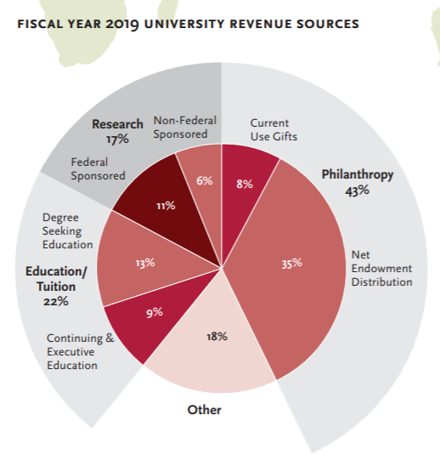
Why Tuition* Matters
*For this analysis, we consider Tuition as Total Cost
Rough Approximation of Value for education
22% of University Revenue
Represents (nominal) barrier to entry
It’s a lot
It gets worse (increases over time)
Notes:
Because in a general sense, when people talk about Tuition, we think of the total cost of attendance, not just the money we pay for classroom instruction and whatnot. Indeed, one might think of the Harvard education as inclusive of the entire experience, beyond simply classes. Then, it makes sense to analyze the data on what we pay for the entire experience.
Can think of education as a service. Then, what we pay is how much the education is worth to us. Or, at least, this is what University thinks its worth to us: we choose whether or not it is worth that much to us. Since we’re here right now, it’s obvious which choice we made.
Can think of tuition as a large source of the University’s revenue. See here that this makes up a nontrivial proportion of the university’s annual income. This chart was taken from the most recent Harvard financial report, published less than 2 weeks ago.
Can think of as a barrier to entry. Yes, FA exists, but the sticker price is still this nominal amount, which serves as a relatively high bar as a barrier to entry, which we will see in detail more later.
Some reasons that are more personal and relevant to Harvard students: it’s a lot, and it gets worse. Now, I basically summarized our entire presentation in two succinct bullet points: it’s a lot, and it gets worse. These are two seemingly trivial statements: we all know that we pay a load of money to be here, and that we have to pay more every year, but these claims actually beg some interesting questions: why does it increase each year? Where do the increases come from? Does the Harvard experience actually improve my the a value commensurate with the increase in costs? Why is it so high to begin with? These are some of the questions that prompted us to investigate this issue in more depth.

Slide 4
Why Tuition* Matters
*For this analysis, we consider Tuition as Total Cost
Rough Approximation of Value for education
22% of University Revenue
Represents (nominal) barrier to entry
It’s a lot
It gets worse (increases over time)
Notes:
Because in a general sense, when people talk about Tuition, we think of the total cost of attendance, not just the money we pay for classroom instruction and whatnot. Indeed, one might think of the Harvard education as inclusive of the entire experience, beyond simply classes. Then, it makes sense to analyze the data on what we pay for the entire experience.
Can think of education as a service. Then, what we pay is how much the education is worth to us. Or, at least, this is what University thinks its worth to us: we choose whether or not it is worth that much to us. Since we’re here right now, it’s obvious which choice we made.
Can think of tuition as a large source of the University’s revenue. See here that this makes up a nontrivial proportion of the university’s annual income. This chart was taken from the most recent Harvard financial report, published less than 2 weeks ago.
Can think of as a barrier to entry. Yes, FA exists, but the sticker price is still this nominal amount, which serves as a relatively high bar as a barrier to entry, which we will see in detail more later.
Some reasons that are more personal and relevant to Harvard students: it’s a lot, and it gets worse. Now, I basically summarized our entire presentation in two succinct bullet points: it’s a lot, and it gets worse. These are two seemingly trivial statements: we all know that we pay a load of money to be here, and that we have to pay more every year, but these claims actually beg some interesting questions: why does it increase each year? Where do the increases come from? Does the Harvard experience actually improve my the a value commensurate with the increase in costs? Why is it so high to begin with? These are some of the questions that prompted us to investigate this issue in more depth.

Slide 5
“College is expensive for many reasons, including a surge in demand, an increase in financial aid, a lack of state funding, a need for more faculty members and money to pay them, and ballooning student services.”
-Business Insider
Notes:
https://www.businessinsider.com/why-is-college-so-expensive-2018-4

Slide 6
What Can Harvard’s Tuition Data Tell Us?
Two-part results:
Total Cost
Specific Costs

Slide 7
1.
Total Cost
Analysis of Total Cost of Attendance at Harvard over Time

Slide 8
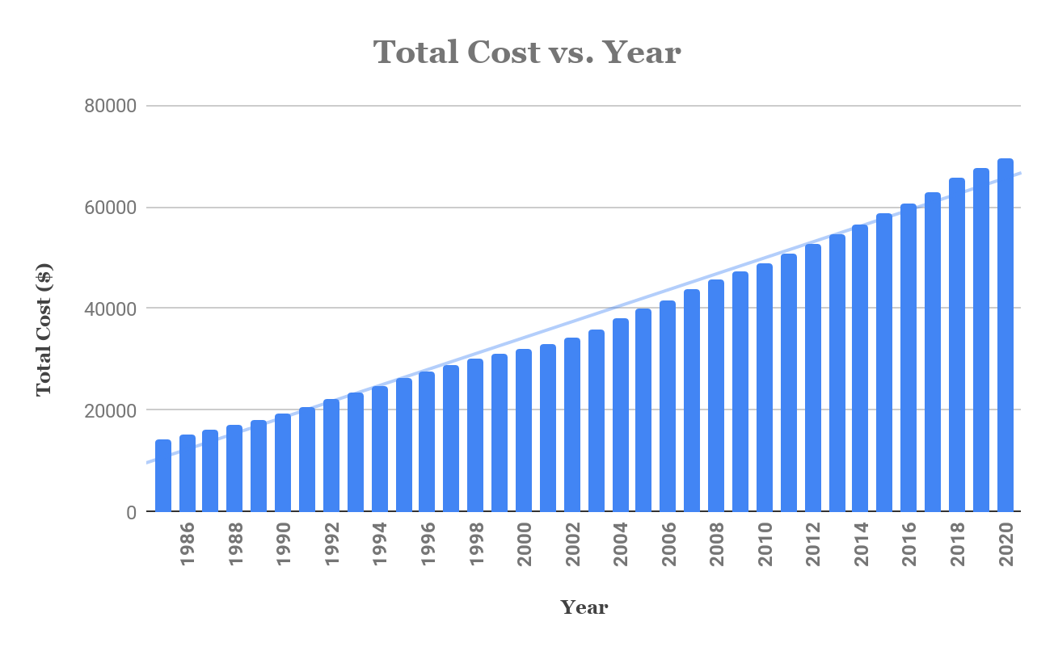
Average increase in total cost over last 10 years: 3.6%

Slide 9
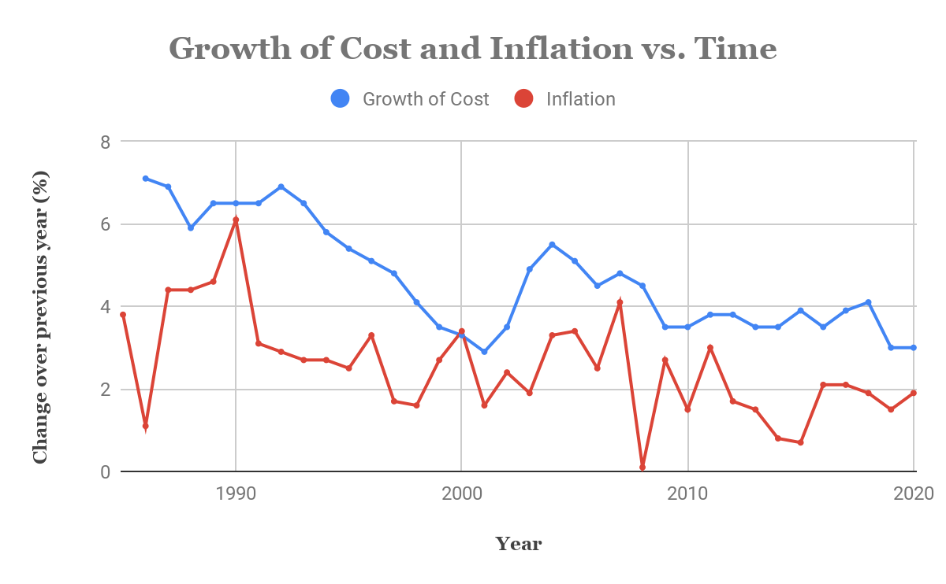
Average difference (cost increase - inflation) over last 10 years: 1.9%
Notes:
With one exception in 2000, growth of the total cost has always exceeded inflation. Indeed, the average difference, which is how much more the cost increase exceeds inflation, has been 1.9%. In other words, the REAL cost, adjusted for inflation, has increased by an average of 1.9% over the last 10 years.

Slide 10
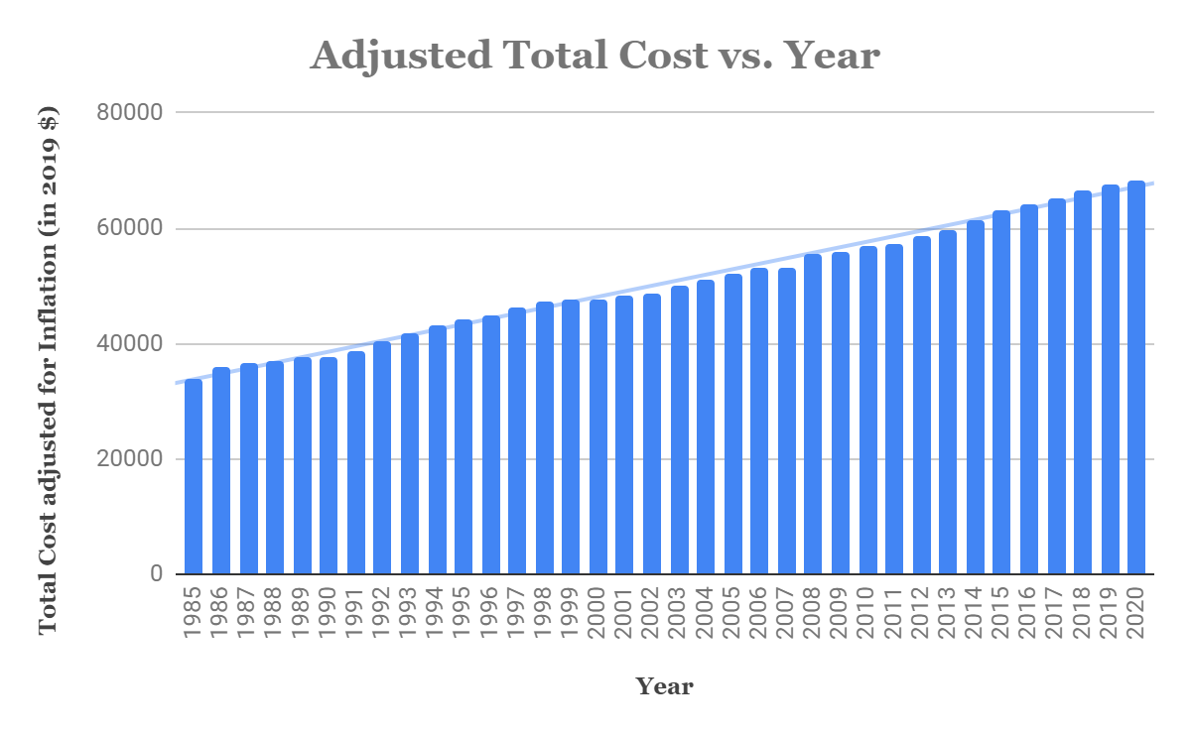
Notes:
We can see that, even adjusted for inflation, total costs are rising, pretty consistently, over time. Some interesting ideas to consider: does this mean Harvard consider the real value of its education to improve each year? Do you, as students and faculty, feel like the experience improves this much each year?

Slide 11
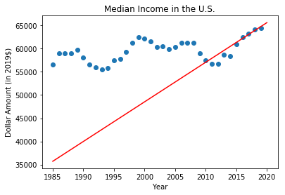
Notes:
Scatter plot: median income in U.S.
Red line: linear regression on last five years to predict median income in 2020 (according to 2019 price level)

Slide 12
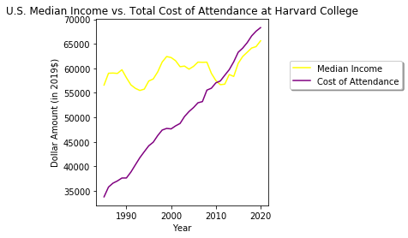

Cost of attendance exceeds income level!
Notes:
It looks like the COA started to exceed the median income of workers in the U.S. circa 2010. Interestingly enough, Harvard College expanded its investment in undergraduate financial aid by $10 million in 2011, providing students with $166 million in need-based scholarships! Beginning in fall 2012, financial aid was also increased for low-income students by raising the income level under which parents pay nothing towards cost of attendance to $65,000.

Slide 13
What will happen if the median income of U.S. workers drops again in the near future, further increasing the gap between the cost of attendance and how much families can afford?

Slide 14
2.
Specific Costs
Analysis of Specific factors contributing to Harvard’s Cost of Attendance

Slide 15
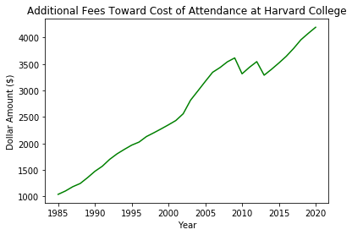
Notes:
Additional fees = student activity fee + health fee
Possible explanation for drop in 2008-09: Obama administration and new health policies?

Slide 16
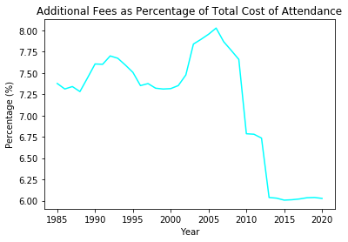
Notes:
There are sudden drops in the percentage of total cost of attendance accounted for by additional fees — this is because the health fee for students was decreased from 2008-09 and 2012-13. In the past five years, the percentage sits somewhere relatively close to 6%.

Slide 17
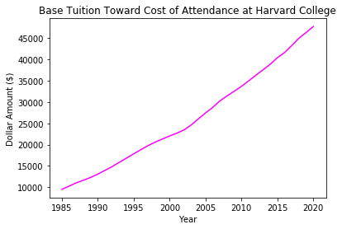
Notes:
There is steady increase in base tuition since the year 1985, but how much of this increase can be attributed to inflation?

Slide 18
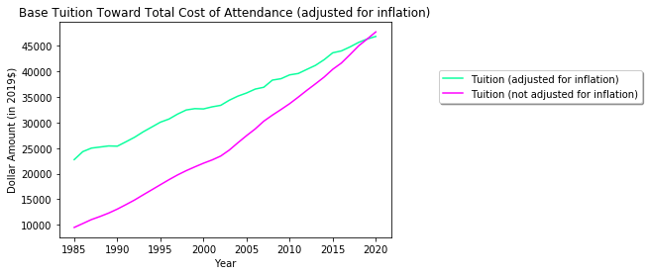
Notes:
Answer: inflation does not significantly affect the increase in base tuition.

Slide 19
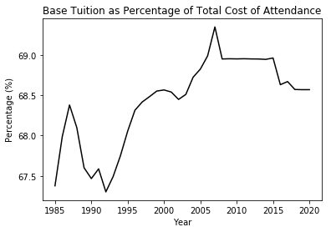
Notes:
Cool looking graph!

Slide 20
Key Takeaways
Harvard is Expen$ive
Even when adjusted for inflation
Especially compared to median income
Tuition is (possibly) responsive to domestic/global affairs
Harvard’s (real) cost increases annually
How can you make sure its value to you increases commensurately?

Slide 21
Future Directions
Look at Room+Board in context of housing market
Compare to Admissions Data
Consider relevant political/social events
Nationally
Harvard community
Compare to changes in peer institution tuitions
For more info, check out our GitHub:
https://github.com/RichardMaS/Harvard-Tuition-Data

Slide 22
Thanks!
Any questions?
richardluo@college.harvard.edu
benji_kan@college.harvard.edu

